Slide 1
DineDash
ER Diagrams

Slide 2
DineDash : List of Entities
Entity Name | Entity Primary Attributes
Users | user_id, name, email, password, street_address, city, state, zip_code, entitlement_type
Restaurants | restaurant_id, restaurant_name, street_address, city, state, zip_code, restaurant_type
Delivery Partners | partner_id, name, email, password, vehicle_type, street_address, city, state, zip_code
Menu Items | menu_item_id, restaurant_id, name, description, price
Reservations | reservation_id, user_id, restaurant_id, date, time, number_of_guests
Orders | order_id, user_id, restaurant_id, total_amount, order_status, partner_id
Payments | payment_id, order_id, subscription_id, user_id, amount_paid, payment_method
Order Items | order_item_id, order_id, menu_item_id, quantity, price
Advertisements | ad_id, target_type, title, content, start_date, end_date, status, restaurant_id
Reviews | review_id, user_id, restaurant_id, rating, comment, created_at
Subscriptions | subscription_id, user_id, subscription_type_id, start_date, end_date, status, payment_id
Subscription Types | subscription_type_id, name, price, duration, description
Offers | offer_id, title, description, discount_percent, discount_amount, valid_from, valid_until, applicable_to
Loyalty Programs | loyalty_id, user_id, points_earned, points_redeemed
Earnings | earning_id, partner_id, order_id, amount, date_earned, tip_amount
Commission Payments | commission_id, order_id, restaurant_id, partner_id, restaurant_com_percent, restaurant_com_amt, delivery_com_percent, delivery_com_amt, created_at
Customer Queries | query_id, user_id, subject, description, created_at, status
Support Tickets | ticket_id, query_id, user_id, status, resolution_notes, resolved_at
Entitlements | entitlement_id, entitlement_type, description
States | state_id, state_name
Zip Codes | zip_id, zip_code
Order Status | status_id, status_name, description
Restaurant Type | restaurant_type_id, type_name, description

Slide 3
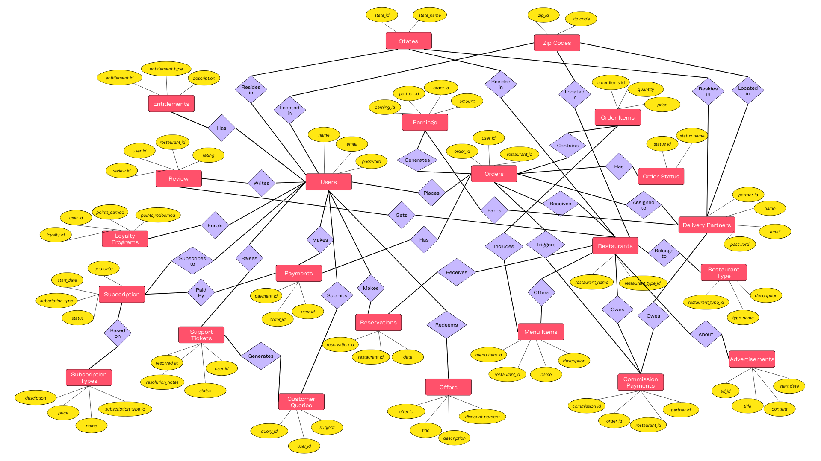
DineDash : Conceptual ER Diagram

Slide 4
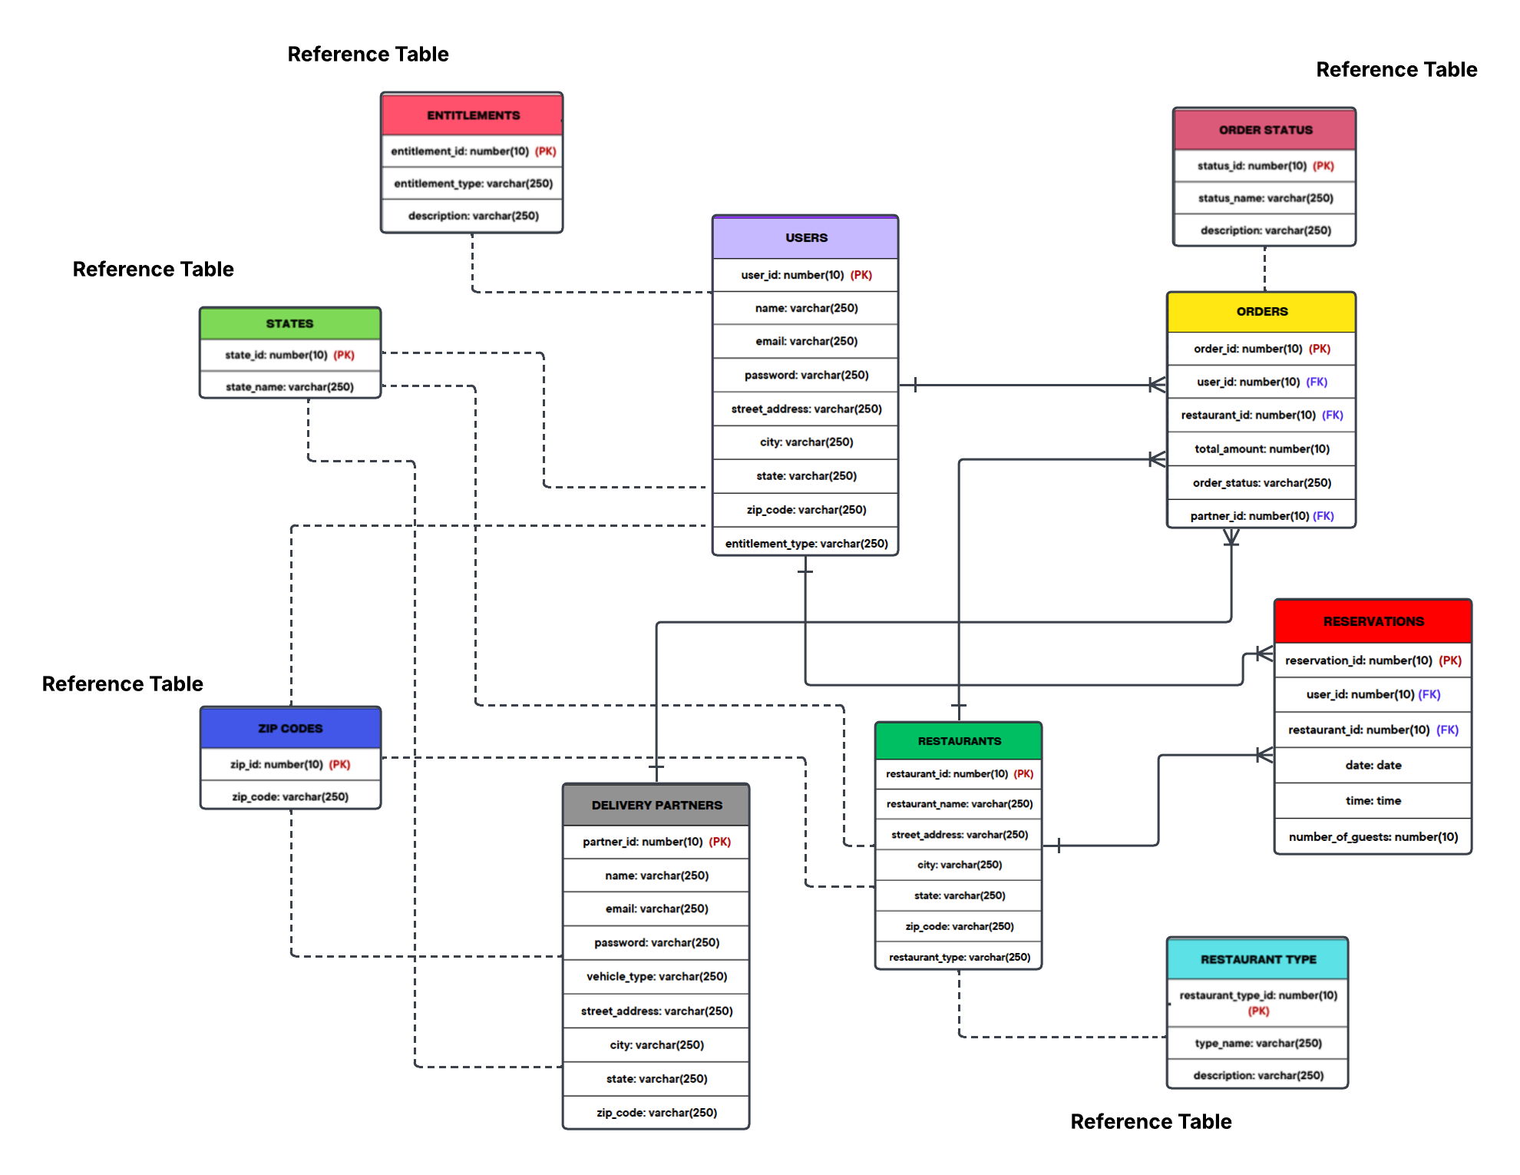
DineDash : Logical ER Diagram

